Slide 1

UNIT-V
SPREAD SPECTRUM TECHNIQUES AND
INFORMATION THEORY CONCEPTS
Session – 1-7
Spread spectrum Communications,
Frequency Hopping Spread Spectrum (FHSS),
Direct Sequence Spread Spectrum (DSSS),
Code Division Multiple Access of DSSS,
Introduction to OFDM Communication

Slide 2
Spread spectrum communications
• In spread spectrum communication, channel bandwidth and transmitted power are
sacrificed for the sake of secure communication.
• The primary advantage of spread spectrum communication is its ability to reject
interference.
• An un-intentional interference is the one in which another user tries to transmit
simultaneously through the same channel.
• In intentional interference the hostile transmitter attempts to jam the transmission.

Slide 3
Spread spectrum
• Spread spectrum is a means of transmission in which the data sequence occupies a
bandwidth in excess of minimum bandwidth necessary to send it.
• The spectrum spreading is accomplished before the transmission through use of
code that is independent of data sequence.
• The same code is used in the receiver to despread the received signal so that the
original sequence may be recovered.

Slide 4
Types of spread spectrum
• Direct-sequence spread spectrum
•
•
•
•
Two stages of modulation used.
First the incoming data sequence is used to modulate a wideband code.
The code transforms narrow band data sequence into noiselike wideband signal.
The wideband signal undergoes second modulation using PSK technique.
• Frequency hop spread spectrum
• The spectrum of data modulated carrier is widened by changing carrier frequency in pseudo-
random manner.
• Both spread spectrum techniques require noise-like spreading code called pseudo
random sequence

Slide 5
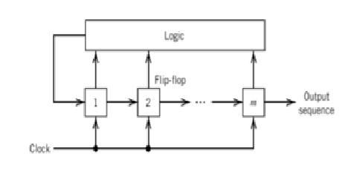
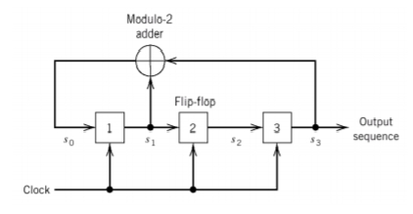
Pseudo noise sequences
• A (digital) code sequence that mimics the (second-order) statistical behavior of a
white noise.
• A pseudo-noise sequence is generated by using several shift-registers and a
feedback through combinational logic.
• Feedback shift register becomes “linear” if the feedback logic consists entirely of
modulo-2 adders.
PN Sequence generator
Linear feedback shift register

Slide 6
Contd…..
• A PN sequence generated by a (possibly non-linear) feedback shift register must
eventually become periodic with period at most 2m, where m is the number of shift
registers.
• A PN sequence generated by a linear feedback shift register must eventually become
periodic with period at most 2m - 1, where m is the number of shift registers.
• A PN sequence whose period reaches its maximum value is named the maximum-length
sequence or simply m-sequence.
• A maximum-length sequence generated from a linear shift register satisfies three
properties
• Balance property: The number of 1s is one more than that of 0s.
• Run property: (total number of runs = 2m-1) i.e., ½ of the runs is of length 1, ¼ of the runs is of
length 2…..and so on.
• The correlation property: The autocorrelation sequence of a maximum-length sequence is periodic.

Slide 7
Frequency hop spread spectrum
• System with larger processing gain can combat effect of jammers.
• However processing gain is a function of PN sequence period.
• PN sequence with narrow chip duration provides larger processing gains.
• Physical devices are not capable of generating narrow chips which imposes limits on
attainable processing gains.
• Also processing gain so attained is not large enough to overcome jammers.
• Alternate method is to force jammers to cover wide spectrum by randomly hopping data
modulated carrier from one frequency to next.

Slide 8
• The spectrum is spread pseudo randomly i.e., random frequency hops.
• Commonly used modulation format for frequency hopped systems is M-Ary frequency
shift keying.
• TYPES:
• Slow frequency hopping – Symbol rate(RS) is equal to integer multiple (Rn)
• Fast frequency hopping – Hop rate(Rh) is equal to integer multiple (Rs)

Slide 9
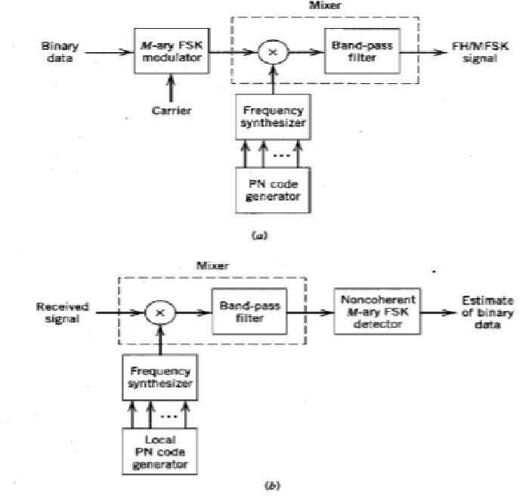
a)Transmitter b)Receiver (common for both)

Slide 10
Slow frequency hopping
• FSK is performed followed by mixing. Incoming binary data is applied to FSK modulator.
The resulting modulated wave and output is applied to mixer consisting of multiplier
followed by BPF.
• Filter is designed to select only sum frequency component.
• K- bit PN sequence drives synthesizer and enables carrier frequency to hop over 2k
distinct values.
• For 2k frequency hops, FH/MFSK occupies larger bandwidth which is much larger than
that achievable by DSSS.
• Inability to maintain phase coherence suggests use of non coherent detection for FHSS.
• Reverse process happens at demodulator side.

Slide 11
• In FHSS, individual FH/MFSK tone is referred to as chip.
• Chip rate is defined by Rc=max(Rh,Rs) where Rh is hop rate and Rs is symbol rate.
• The bit rate Rb, Rs, Rc and Rh are related by Rc=Rs=
𝑅𝑏
𝐾
≥Rh where k=log2M.
• MFSK tones are separated in frequency by integer multiple of Rc=Rs ensuring
orthogonality.
• If jammer spreads its average power J over the entire frequency hopped spectrum with
bandwidth Wc and power spectral density No/2 where N0=J/Wc.
• Symbol energy to noise spectral density ratio is E/N0=(P/J)/(Wc/Rs).
• Processing gain is defined by PG=WC/RS=2k and PG(in dB)=10log102k=3K where k is
length of PN sequence.

Slide 12
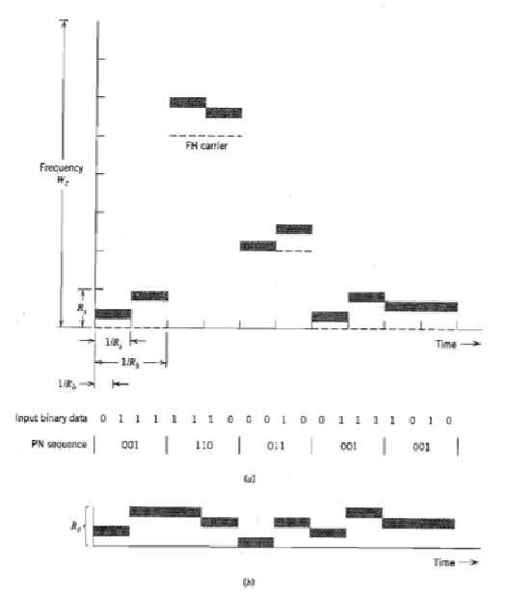
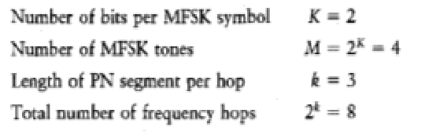
Slow frequency hopping a) Frequency variation for one complete
period of PN sequence b) Variation of de-hopped frequency with time

Slide 13
Fast frequency hopping
• Fast FH/MFSK system has multiple hops per M-Ary symbol.
• To overcome jammer, the transmitted signal must be hopped to new carrier frequency
before the jammer could interfere.
• Non coherent detection is used which is slightly different from slow FH/MFSK.
• 2 procedures are considered
• For each FH/MFSK symbol, separate decisions are made on k frequency hop chips
received and majority vote is used to estimate the symbol.
• For each FH/MFSK symbol, likelihood functions are computed and largest one is
selected.
• Receiver based on second procedure is optimum as it minimizes probability of symbol
error.

Slide 14
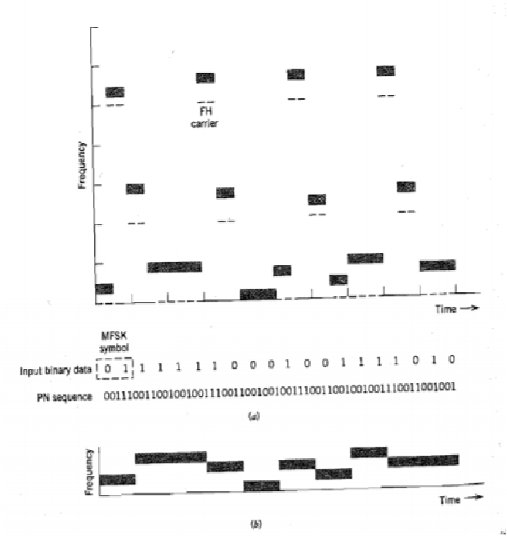
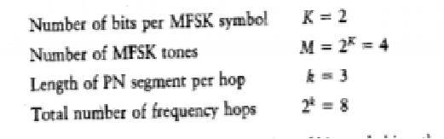
Fast frequency hopping a)Variation of transmitter frequency with
time b) Variation of de-hopped frequency with time

Slide 15
Direct sequence spread spectrum
• Spread spectrum modulation provides protection against externally generated jamming
signals.
• It may be broadband noise or multitone waveform that disrupts communications.
• To protect information bearing signal from jamming signal it is made to occupy a
bandwidth far in excess of minimum bandwidth required.
• This makes transmitted signal appear like noise and can be considered as camouflaging
the information bearing signal.
• Modulation can be used to widen the bandwidth.

Slide 16
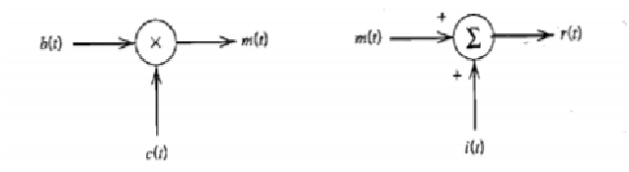
Contd…..
Transmitter
Channel
• bk-binary data sequence, ck-pseudo noise sequence, b(t) and c(t) is polar NRZ representation.
• b(t) and c(t) is applied to product modulator or multiplier.
• b(t) is narrowband and c(t) is wideband. Their product m(t) will have spectrum same as
wideband PN signal.
• PN sequence acts as spreading code.

Slide 17
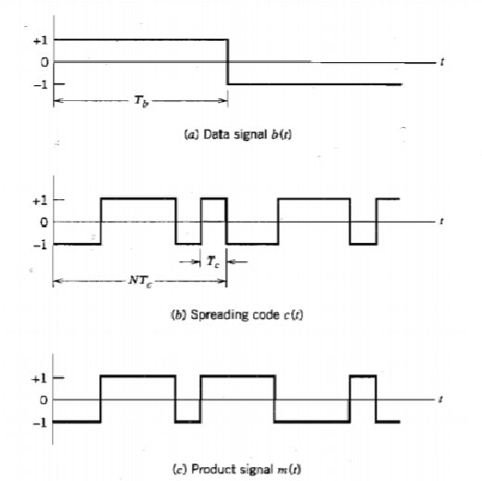
• By multiplying b(t) with c(t), the information bit is chopped and are called as chips.
• Transmitted signal m(t)=c(t).b(t)

Slide 18
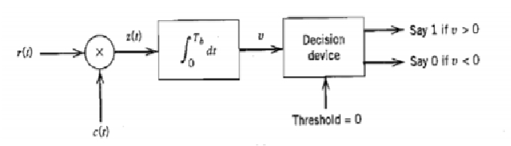
• The received signal r(t) consists of transmitted signal m(t) and additive
interference denoted as i(t).
r(t)=m(t)+i(t)
r(t)=c(t).b(t)+i(t)
Receiver
• r(t) is applied to demodulator that consists of multiplier followed by integrator and
decision device
• c(t) is exact replica of that used in the transmitter to provide synchronization.
• Multiplier output is given by
Z(t)=c(t).r(t)
Z(t)=c^2(t).b(t)+c(t).i(t)

Slide 19
• PN signal c(t) alternates between +1 and -1 and it becomes +1 when it is squared.
C^2(t)=1
A
t
• Z(t) becomes Z(t)=b(t)+c(t).i(t)
• b(t) is produced at receiver. In addition there is interference term i(t) multiplied by c(t).
c(t) spreads i(t).
• b(t) is narrowband. c(t).i(t) is wideband.
• By applying multiplier output to LPF, b(t) is recovered and c(t).i(t) is filtered out.
• LPF action is performed by integrator that carries out integration over 0 ≤ t ≤ Tb
providing V
• If V>0, binary 1 is sent
• If V<0, binary 0 is sent
• If V=0, random guess is made in favor of 1 or 0.

Slide 20
Points to note:
• Longer the period of spreading code, closer will be the transmitted signal to be truly
random and harder it is to detect.
• But transmission bandwidth is increased. Also system becomes complex and processing
delay will be more.
• TO HAVE A SECURE TRANSMISSION, THESE ARE NOT UNREASONABLE
COSTS TO PAY

Slide 21
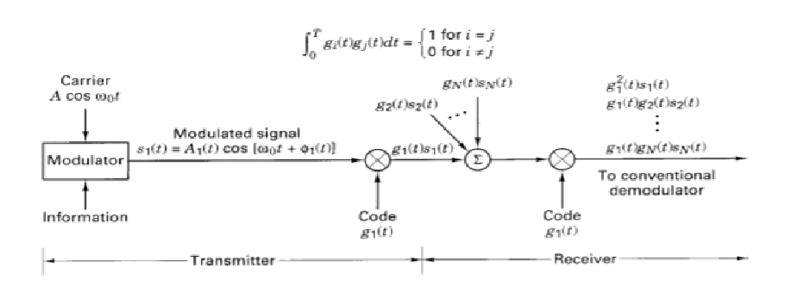
Code division multiple access of DSSS
• Each N user group is given its own code.
• The user codes are approximately orthogonal, so that the cross correlation of two different
codes is near zero.
• The main advantage of CDMAsystem is that all the participants can share the full
spectrum of the resource asynchronously.

Slide 22
• The modulator modulates the carrier and its output belong to the user from group1.
• The modulated signal is multiplied by the spreading signal g1(t) belonging to group 1 and resulting
signal is transmitted over the channel.
• Simultaneously users from group2 through N multiply their signals by their own code.
• Codes are restricted from unauthorized access.
• The signal present at the receiver is the linear combination of emanation from each of the user.
• Signal is narrow band when compared with the code and hence the product will have
approximately the bandwidth of the code in CDMA.
• Code should be orthogonal to each other.
• At the receiver perfectly generated code yields original signal back. But practically codes are not
orthogonal. Therefore performance degradation occurs which limits the number of simultaneous
users.

Slide 23
OFDM communication
• OFDM transmits information on multiple carriers contained within the allocated channel
bandwidth.
• The primary motivation for transmitting the data on multiple carriers is to reduce ISI and
eliminate performance degradation.
• Multicarrier modulation divides the available channel bandwidth into subbands of narrow
bandwidthΔf=W/N.
• It yields transmission rates close to channel capacity.
• The signal in each sub band may be independently coded and modulated at synchronous
symbol rate of 1/Δf.
• If Δf is small, the channel frequency response is constant across each subband. So ISI will
be negligible.

Slide 24
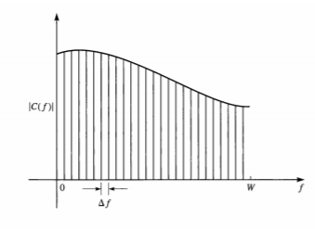



Subdivision of the channel bandwidth W into narrowband sub channels of equal widthΔf.
• With each sub band (or sub channel), we associate a sinusoidal carrier signal of the form
• where fk is the mid frequency in the kth sub channel. By selecting the symbol rate 1/T in
each of the sub channels to be equal to the frequency separation Δf of the adjacent
subcarriers, the subcarriers are orthogonal over the symbol interval T, independent of the
relative phase relationship between subcarriers. That is,
• where
independent of the values of the phases φk and φj

Slide 25
• OFDM is a special type of multicarrier modulation in which the subcarriers of the
corresponding sub channels are mutually orthogonal.
• Multicarrier modulation (OFDM) is widely used in both wire line and radio channels. For
example, OFDM has been adopted as a standard for digital audio broadcast applications
and wireless local area networks based on the IEEE 802.11 standard.
• A particular suitable application of OFDM is in digital transmission over copper wire
subscriber loops.
• OFDM with optimum power distribution provides the potential for a higher transmission
rate.

Slide 26
References
Simon Haykin and Michael Moher, “Communication Systems,” 5th edition, John Wiley & Sons, 2013.
Singh. R. P & Sapre. S. D, “Communication Systems: Analog & Digital,” 3rd edition, McGrawHill Education, Seventh Reprint, 2016.

